Slide 1
Cate Desktop (GUI) Cate Programming (API) Cate Command Line (CLI)

Slide 2
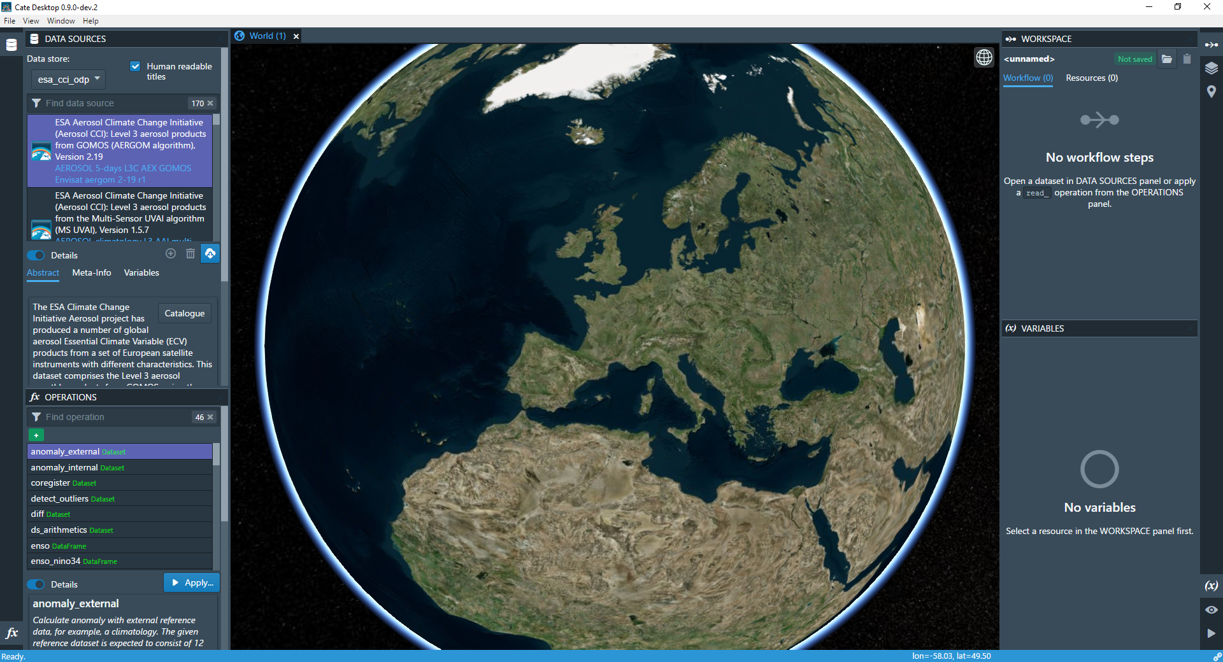
Cate Desktop

Slide 3
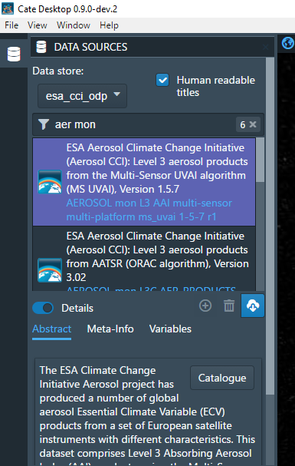
ECV Data Sources
Browse datasets published by CCI Open Data Portal
Download full datasets or just subsets
Temporal subset
Spatial subset
Variable subset
Manage also your local data sources

Slide 4
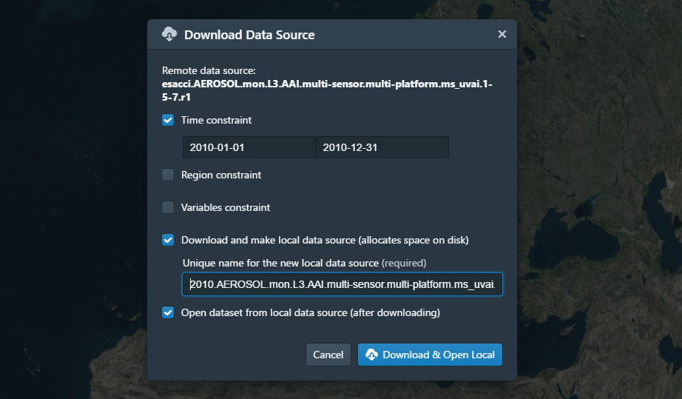
Access CCI Data directly from ODP

Slide 5
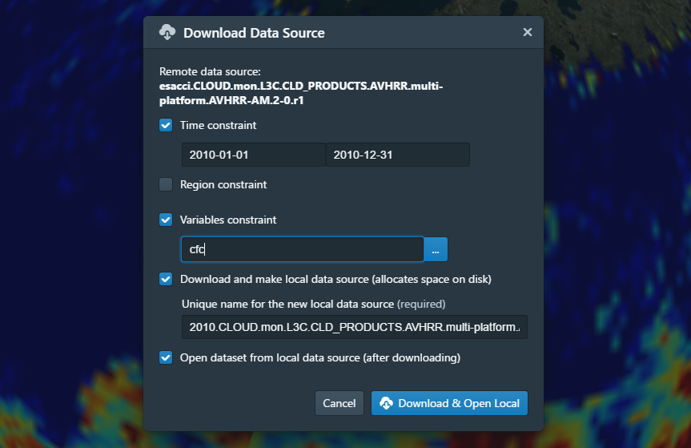
Constraining the Selection

Slide 6
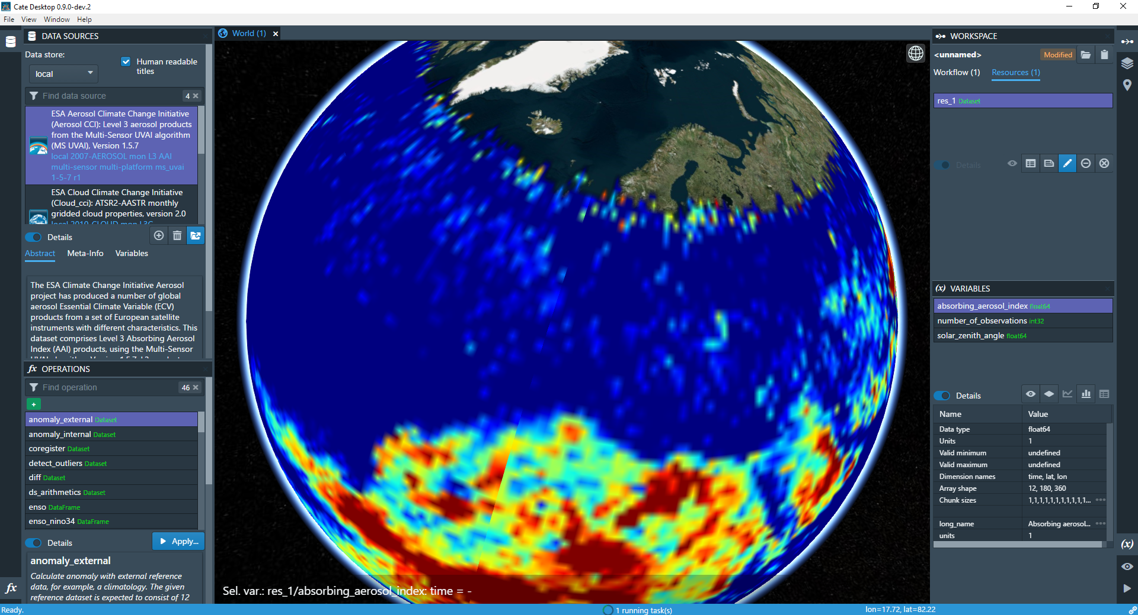
Open and Explore ECV data

Slide 7
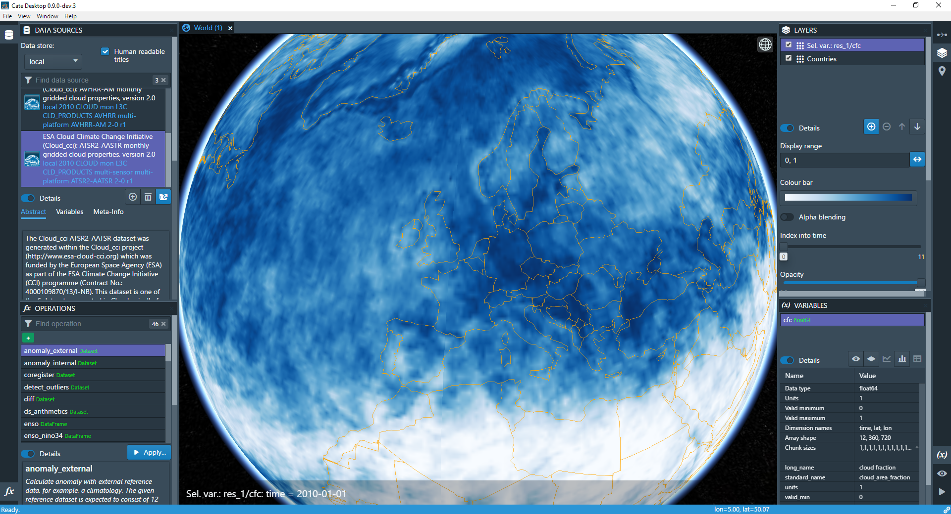
Open CCI Cloud ECV for 2010

Slide 8
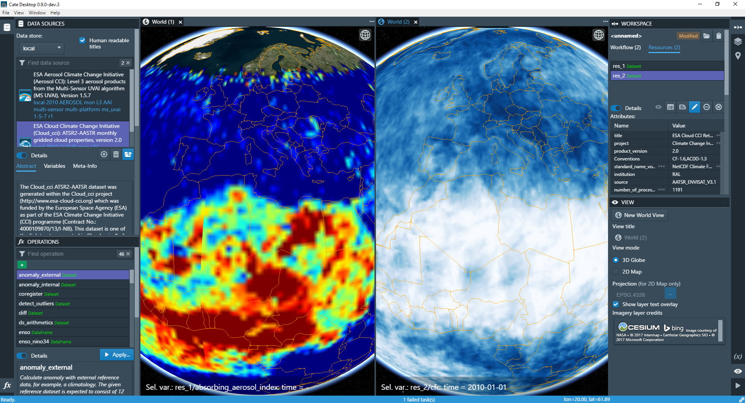
Multiple Views – Compare ECVs

Slide 9
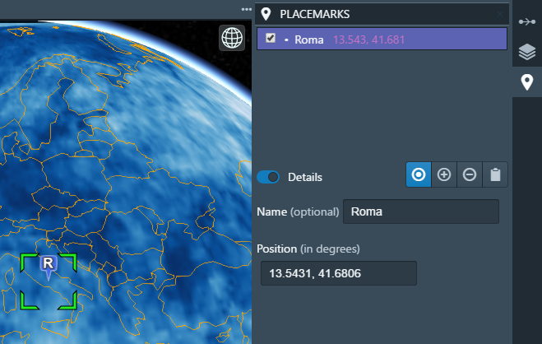
Time Series
Create time series plot easily from selected placemark
and selected variable

Slide 10
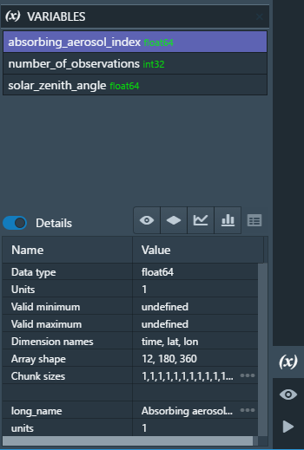
Time Series
Create time series plot easily from selected placemark
and selected variable

Slide 11
Time Series
Create time series plot easily from selected placemark
and selected variable

Slide 12
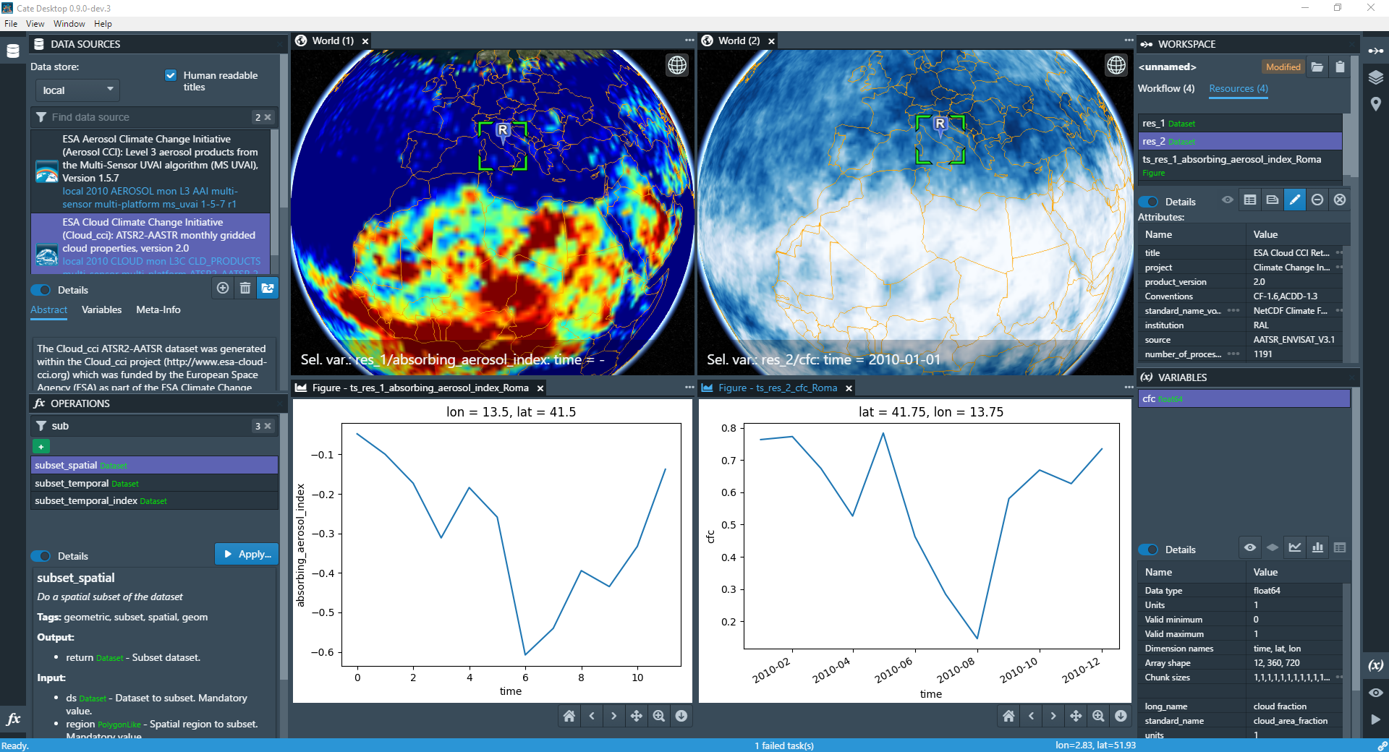
Time Series

Slide 13
Cate Desktop (GUI) Cate Programming (API) Cate Command Line (CLI)
Workspace and Workflow

Slide 14
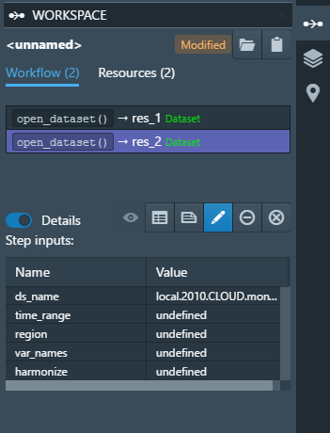
Workspace and Workflow
Every step you perform, is a step of a workflow within your workspace

Slide 15
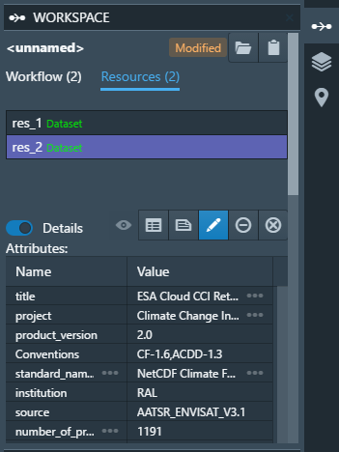
Workspace and Workflow
Every step you perform, is a step of a workflow within your workspace
The result of every step is a new resource which can be used as input to another step

Slide 16
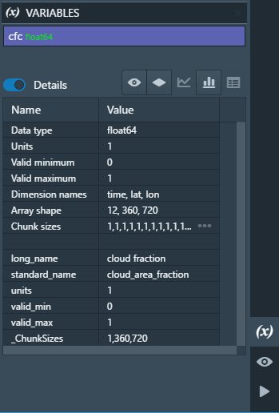
Workspace and Workflow
Every step you perform, is a step of a workflow within your workspace
The result of every step is a new resource which can be used as input to another step
(NetCDF) dataset resources contain the actual geo-physical ECVs

Slide 17
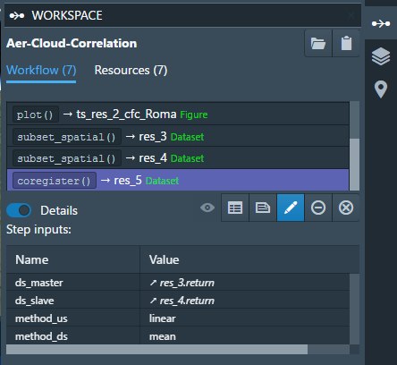
Python Programming & Batch Processing
Remember, every operation is a new workflow step

Slide 18
Python Programming & Batch Processing
Remember, every operation is a new workflow step
Same workflows can be executed from Python or from the Command-Line Interface (CLI)

Slide 19
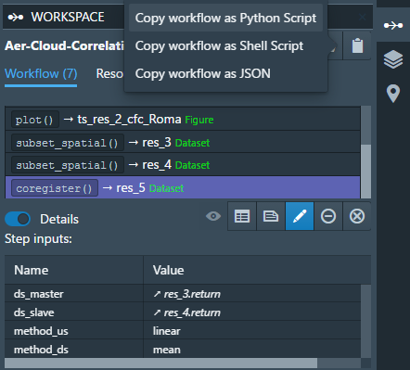
Python Programming & Batch Processing
Remember, every operation is a new workflow step
Same workflows can be executed from Python or from the Command-Line Interface (CLI)

Slide 20
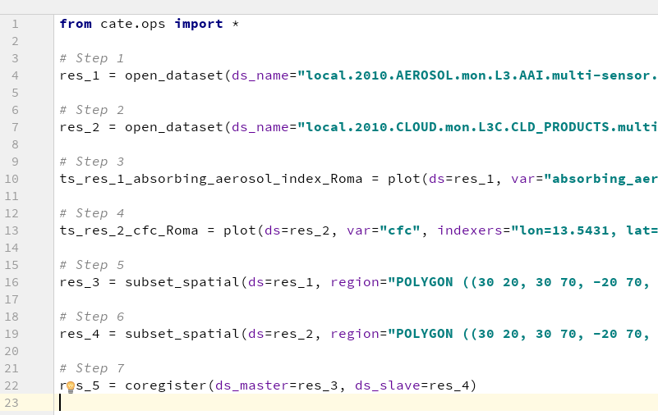
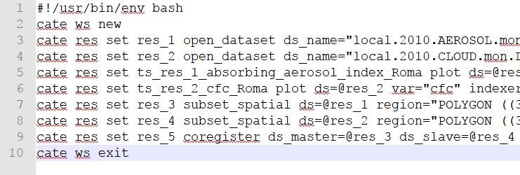
Python Programming & Batch Processing
Exported Python Code
Exported CLI Calls

Slide 21
Cate Desktop (GUI) Cate Programming (API) Cate Command Line (CLI)
Data Analysis

Slide 22
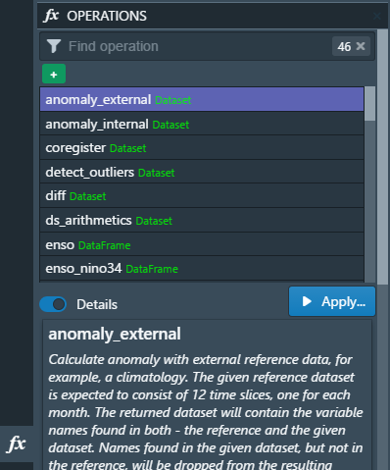
Data Analysis
CCI Toolbox comes with a library of operations

Slide 23
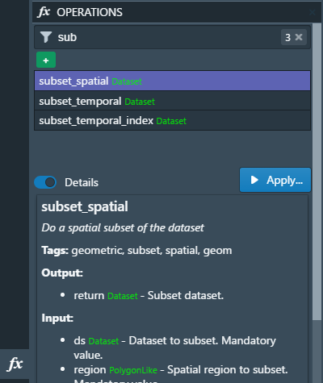
Data Analysis
CCI Toolbox comes with a library of operations
Type to find operations, e.g. subset

Slide 24
Data Analysis
CCI Toolbox comes with a library of operations
Type to find operations, e.g. subset
Operations are usual Python functions – it is very easy to implement your own!
An operation's user interface is generated on-the-fly

Slide 25
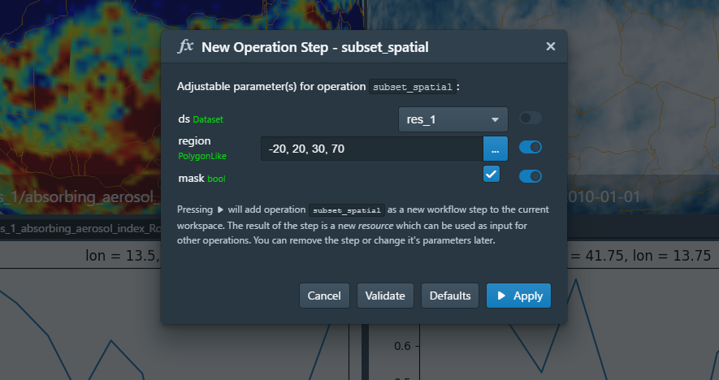
Spatial Subsetting

Slide 26
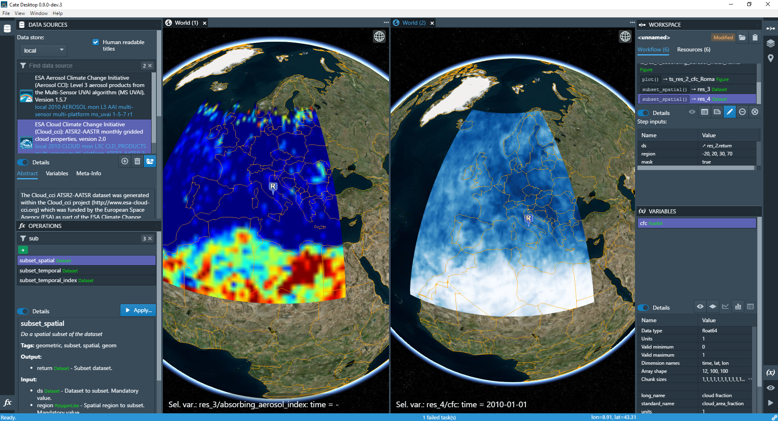
Spatial Subsetting

Slide 27
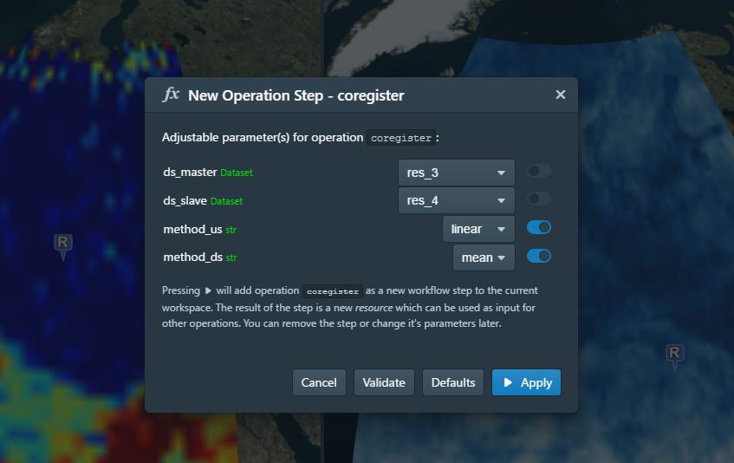
Dataset Co-registerion

Slide 28
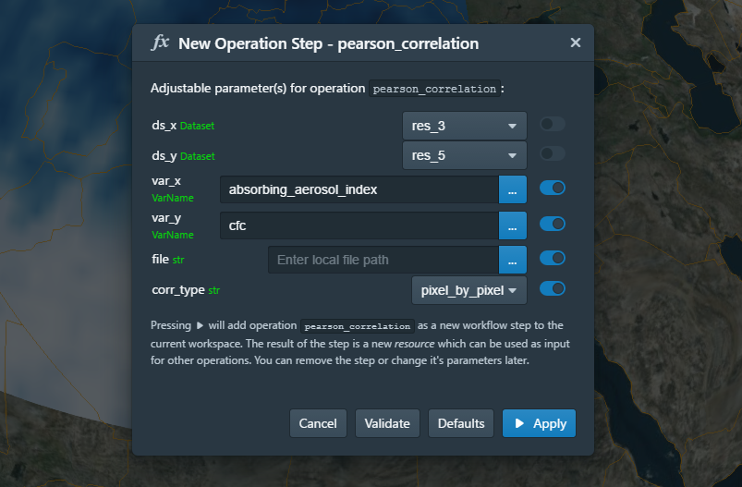
ECV Correlation

Slide 29
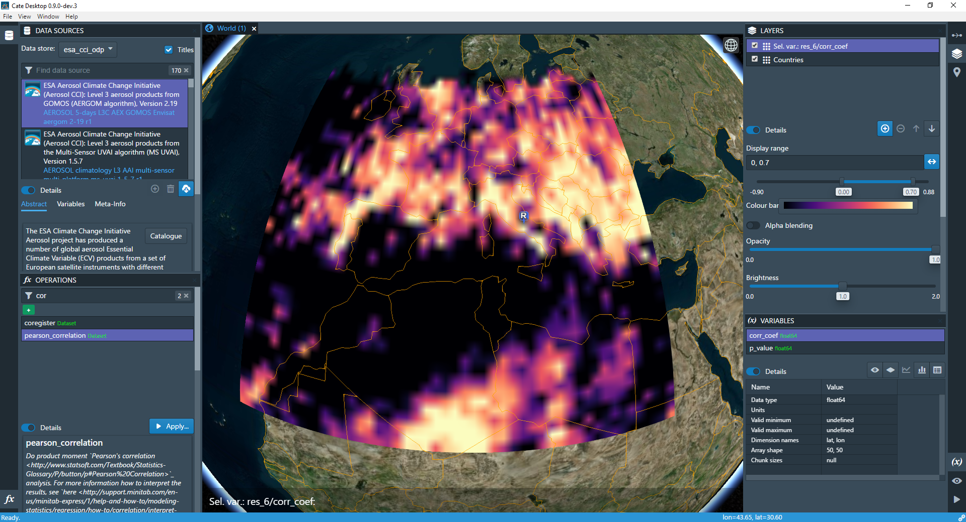
Aerosol/Cloud Correlation in 2010

Slide 30
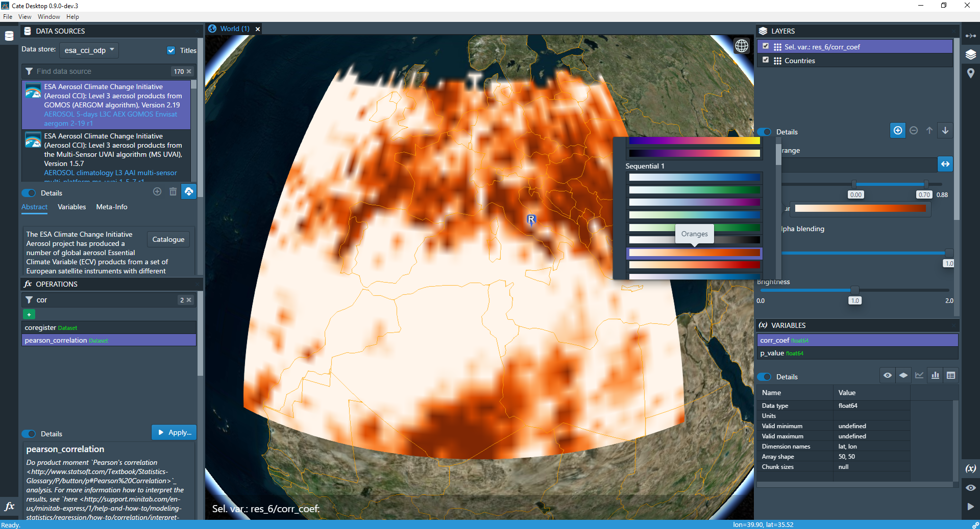
Aerosol/Cloud Correlation in 2010

Slide 31
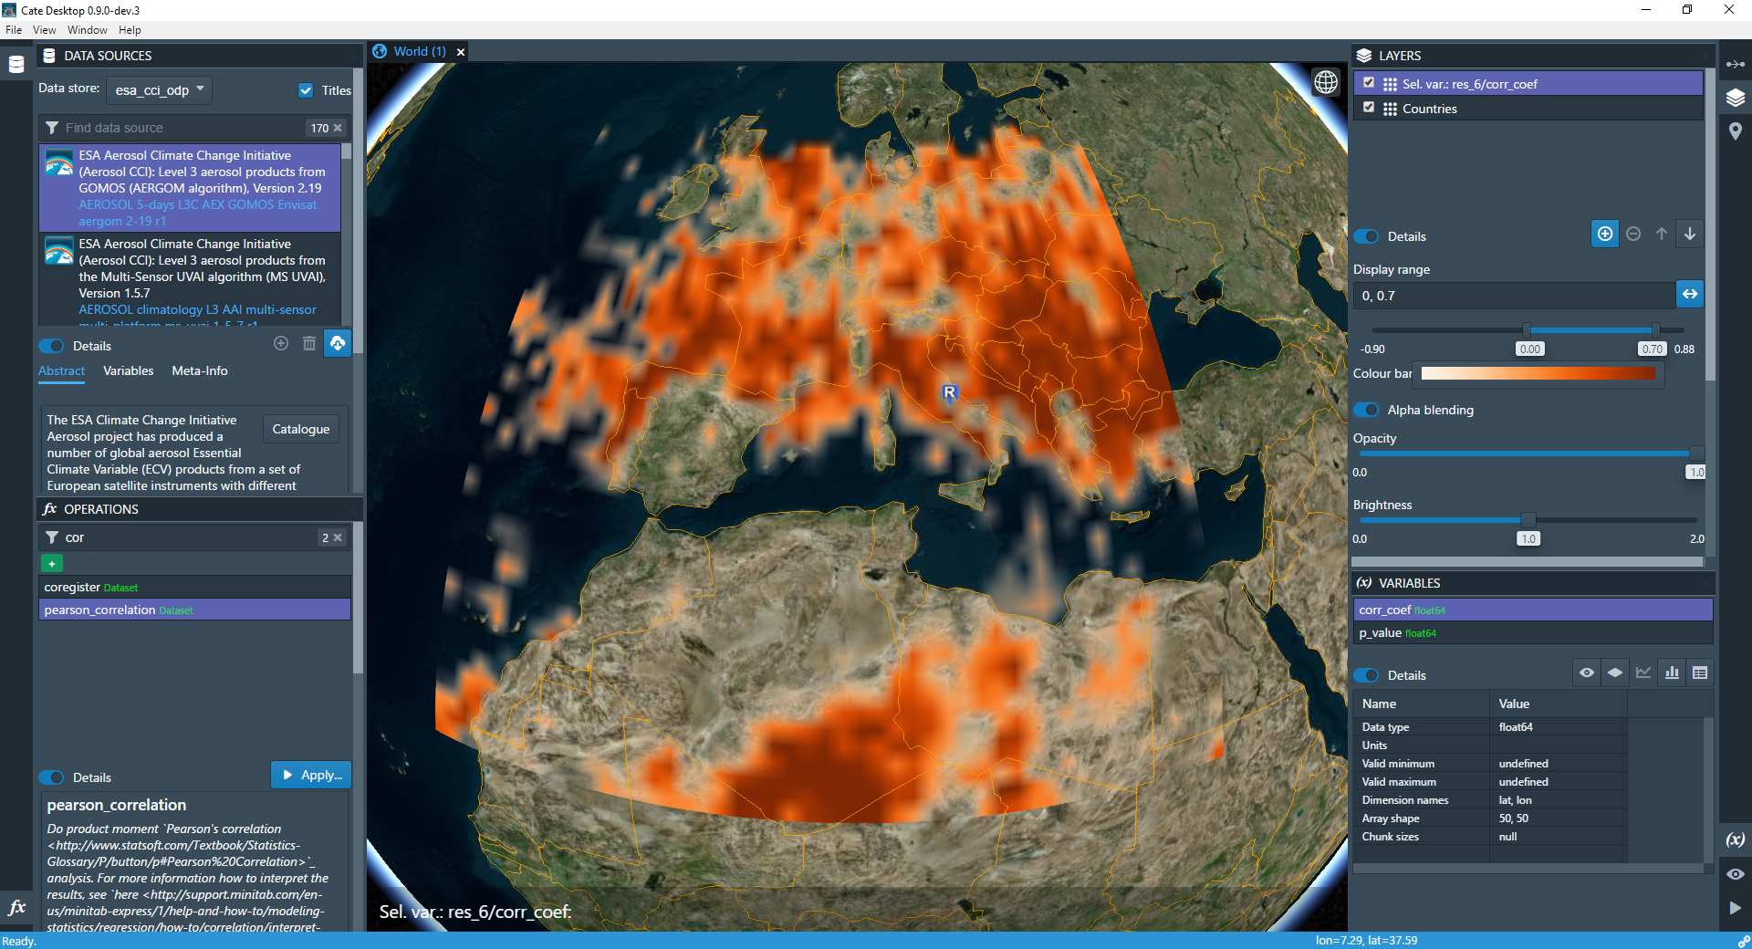
Aerosol/Cloud Correlation in 2010

Slide 32
Give it a Try!
Releases (0.9.0.dev3)
https://github.com/CCI-Tools/cate-core/releases
Source Code (MIT Open Source License)
https://github.com/CCI-Tools/cate-core
https://github.com/CCI-Tools/cate-desktop (GUI)
Documentation
http://ect-core.readthedocs.io/en/latest/

